Slide 1
Functions
Session-VIII

Slide 2
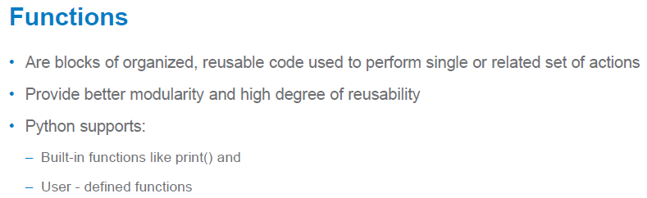

Slide 3
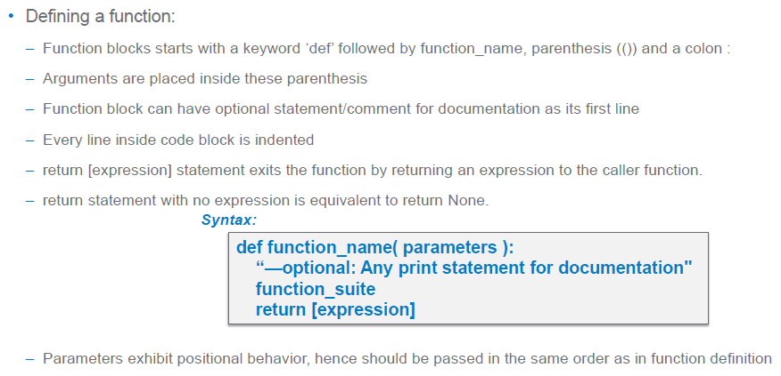
Function…

Slide 4
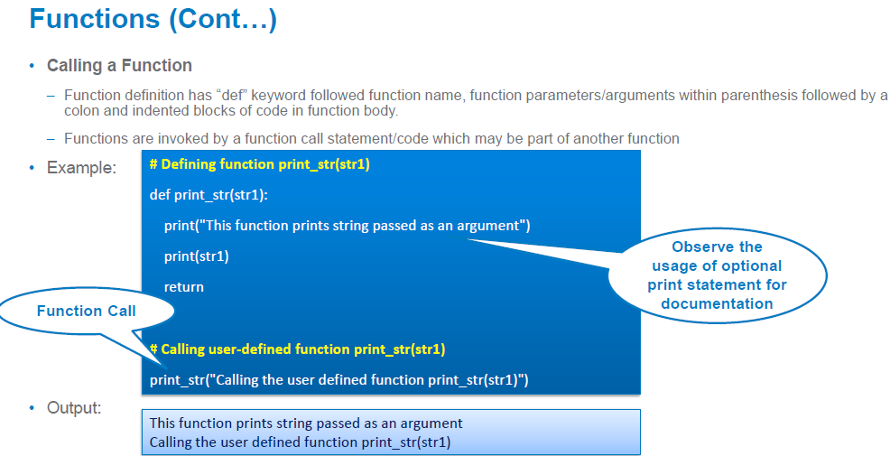
Function…

Slide 5
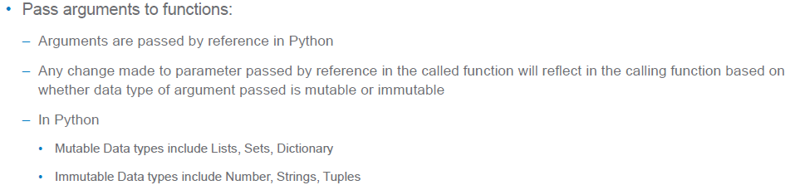
Functions…

Slide 6
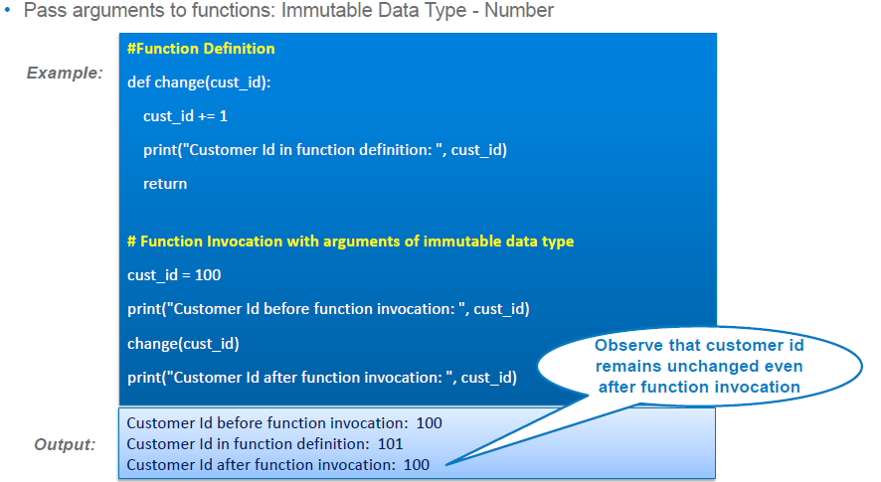
Function..

Slide 7
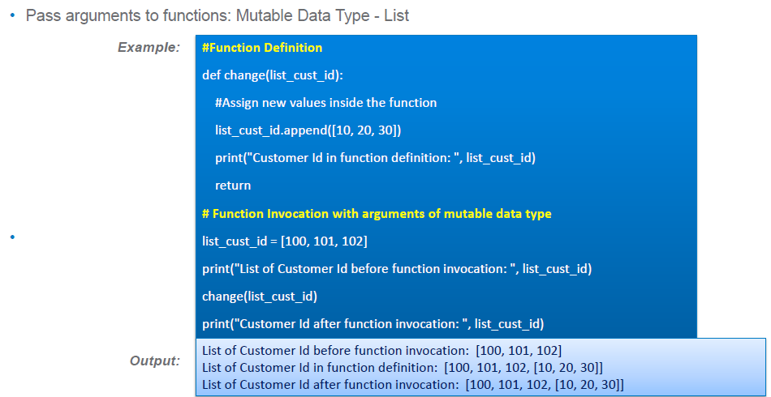
Functions…

Slide 8
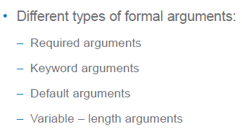
Arguments

Slide 9
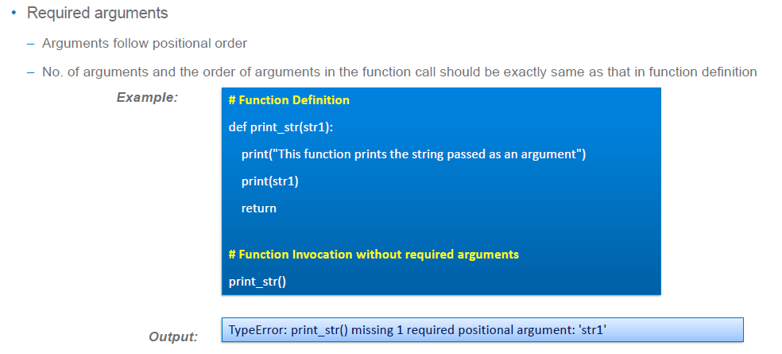
Required Arguments

Slide 10
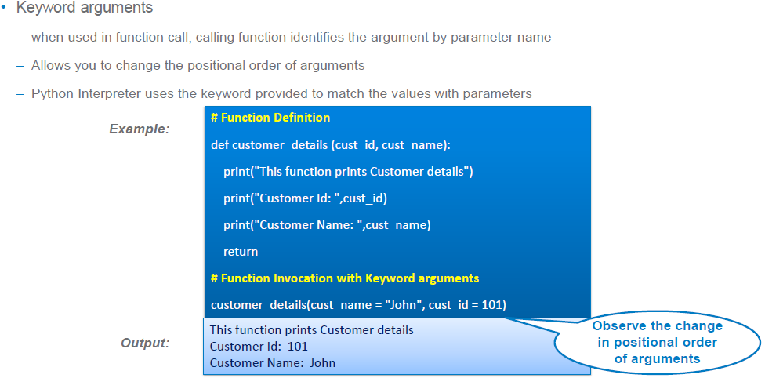
Keyword Arguments

Slide 11
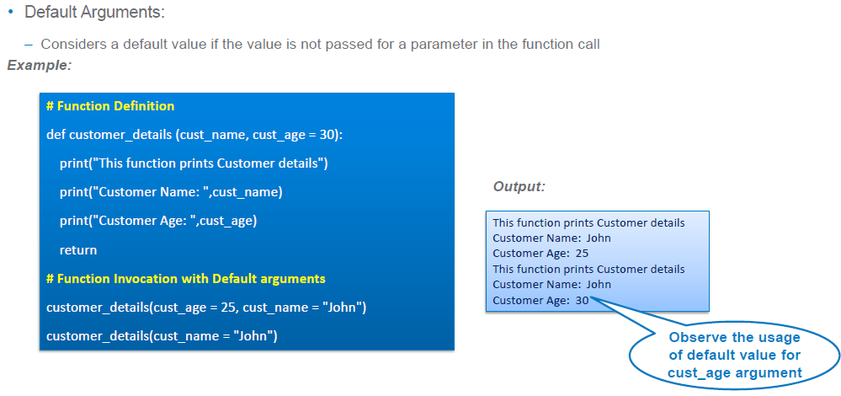
Default Arguments

Slide 12
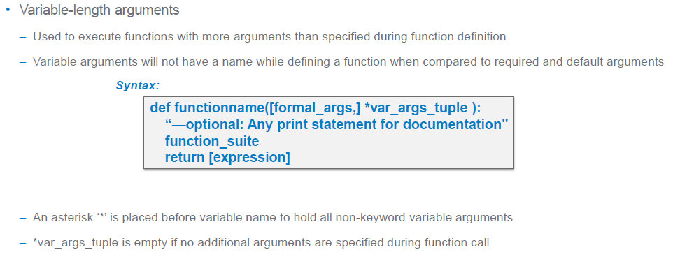
Variable Length Argument

Slide 13
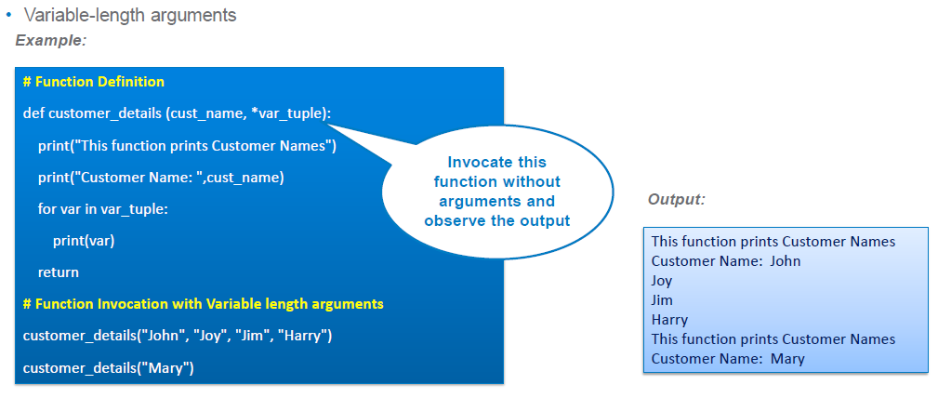
Ex.

Slide 14
Lambda
"""Lambda is a tiny function just like macro
in C"""
import math
square=lambda n:n*n
print(square(4))
"""without arguement"""
x=lambda : math.factorial(4)
y=x()
print(y)
x=lambda x: math.factorial(x)
y=x(3)
print(y)
z=lambda:sum(range(1,4))
y=z()
print(y)
p=lambda x:print(x)
p("hello world")
w=square(3)
print(w)

